Slide 1
Automatic watering system for plants

Slide 2
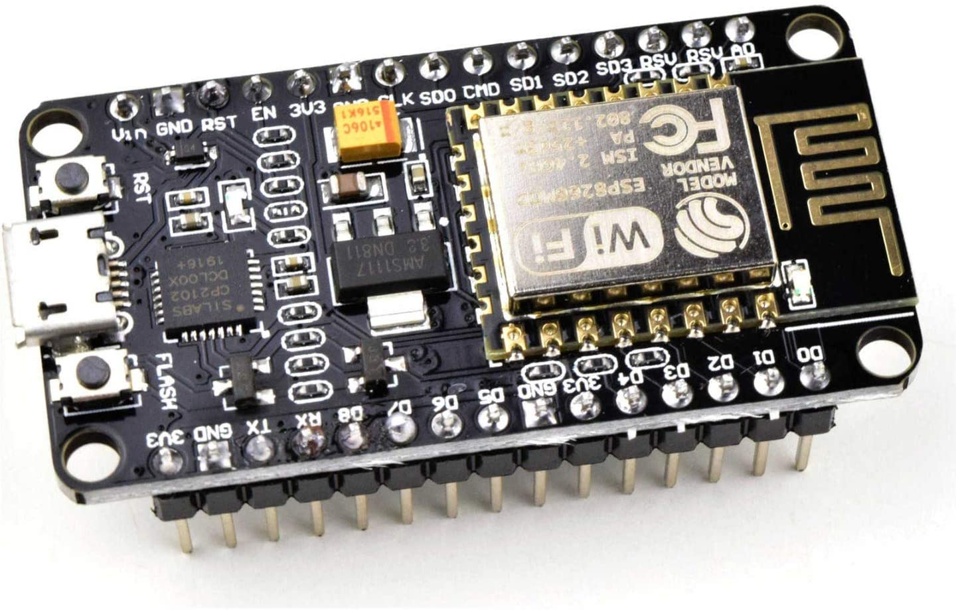
Interfacing of Beaglebone black to ESP8266
Submitted by…,
Induja Sudhish(c0769921)
Group 6

Slide 3

Table of contents
Project overview
Components required
Introduction to ESP8266
Introduction to thingspeak
Interfacing
Final result
References

Slide 4

Automatic watering system for plants
An embedded system which automatically controls the irrigation of the plants. Different sensors are used to sense the data from the soil and water the plants accordingly. This data is sensed by the beagle bone black and it is send to cloud via nodemcu and ThingSpeak.This information is recorded in the cloud server and can be accessed by the user.

Slide 5
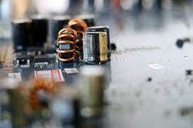
Components required
HARDWARE COMPONENTS
Beagle bone black
ESP8266 NodeMCU
USB cables
Jumper wires
SOFTWARE COMPONENTS
Putty
Arduino IDE

Slide 6
Introduction to ESP8266
NodeMCU is an open source platform based on ESP8266 which can connect objects and let data transfer using the Wi-Fi protocol.

Slide 7
The general features of this board are as follows:
Easy to use
Programmability with Arduino IDE or IUA languages
Available as an access point or station practicable in Event-driven API applications
Having an internal antenna Containing 13 GPIO pins, 10 PWM channels, I2C, SPI, ADC, UART, and 1-Wire

Slide 8
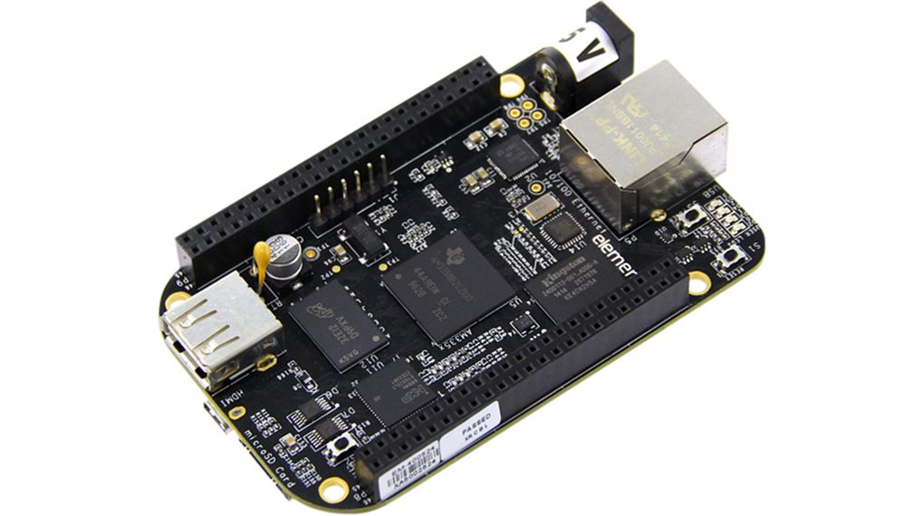
Node MCU ESP266
The NodeMCU ESP8266 development board comes with the ESP-12E module containing ESP8266 chip having Tensilica Xtensa 32-bit LX106 RISC microprocessor.
This microprocessor supports RTOS and operates at 80MHz to 160 MHz adjustable clock frequency.

Slide 9
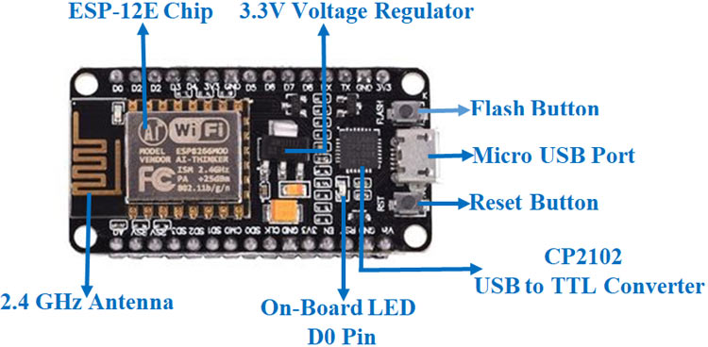
Cont..
NodeMCU has 128 KB RAM and 4MB of Flash memory to store data and programs.
Its high processing power with in-built Wi-Fi / Bluetooth and Deep Sleep Operating features make it ideal for IoT projects.

Slide 10
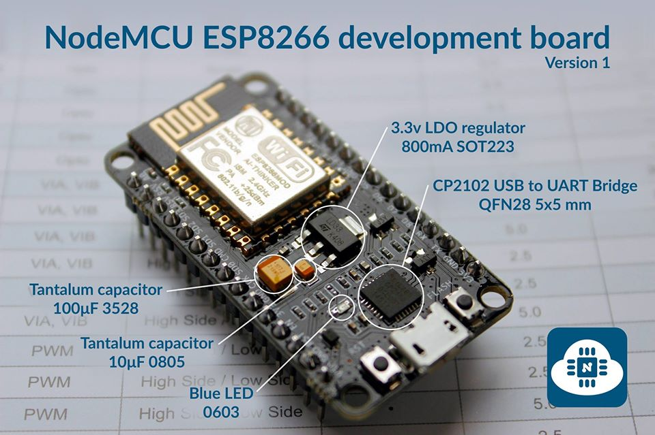
Cont…
It can be powered using Micro USB jack and VIN pin (External Supply Pin). It supports UART, SPI, and I2C interface.
The NodeMCU Development Board can be easily programmed with Arduino IDE since it is easy to use.

Slide 11
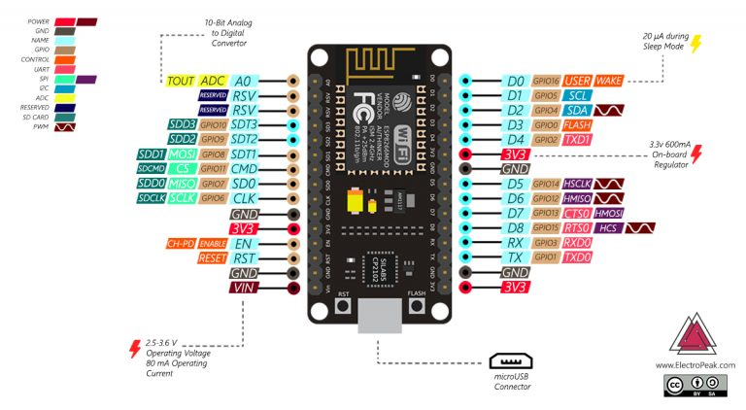
Pinout

Slide 12
Explanation
Pin category | Name | Description
Power | Micro-USB, 3.3V, GND, Vin | Micro-USB: NodeMCU can be powered through the USB port 3.3V: Regulated 3.3V can be supplied to this pin to power the board GND: Ground pins Vin: External Power Supply
Control Pins | EN, RST | The pin and the button resets the microcontroller
Analog Pin | A0 | Used to measure analog voltage in the range of 0-3.3V

Slide 13
GPIO Pins | GPIO1 to GPIO16 | NodeMCU has 16 general purpose input-output pins on its board
SPI Pins | SD1, CMD, SD0, CLK | NodeMCU has four pins available for SPI communication.
UART Pins | TXD0, RXD0, TXD2, RXD2 | NodeMCU has two UART interfaces, UART0 (RXD0 & TXD0) and UART1 (RXD1 & TXD1). UART1 is used to upload the firmware/program.
I2C Pins |  | NodeMCU has I2C functionality support but due to the internal functionality of these pins, you have to find which pin is I2C.

Slide 14
Introduction to thingspeak
ThingSpeak is a platform providing various services exclusively targeted for building IoT. applications

Slide 15
Getting started
Open https://thingspeak.com/ and click on the ‘Get Started Now’ button on the center of the page
We will be redirected to the sign-up page. Fill out the required details and click on the ‘Create Account’ button.
And click on new channel in the final page.

Slide 16
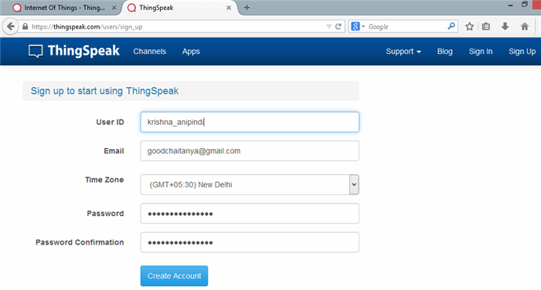

Slide 17
Cont…
The core element of ThingSpeak is a ‘ThingSpeak Channel’.
A channel stores the data that we send to ThingSpeak and comprises of the below elements:
8 fields for storing data of any type - These can be used to store the data from a sensor or from an embedded device

Slide 18
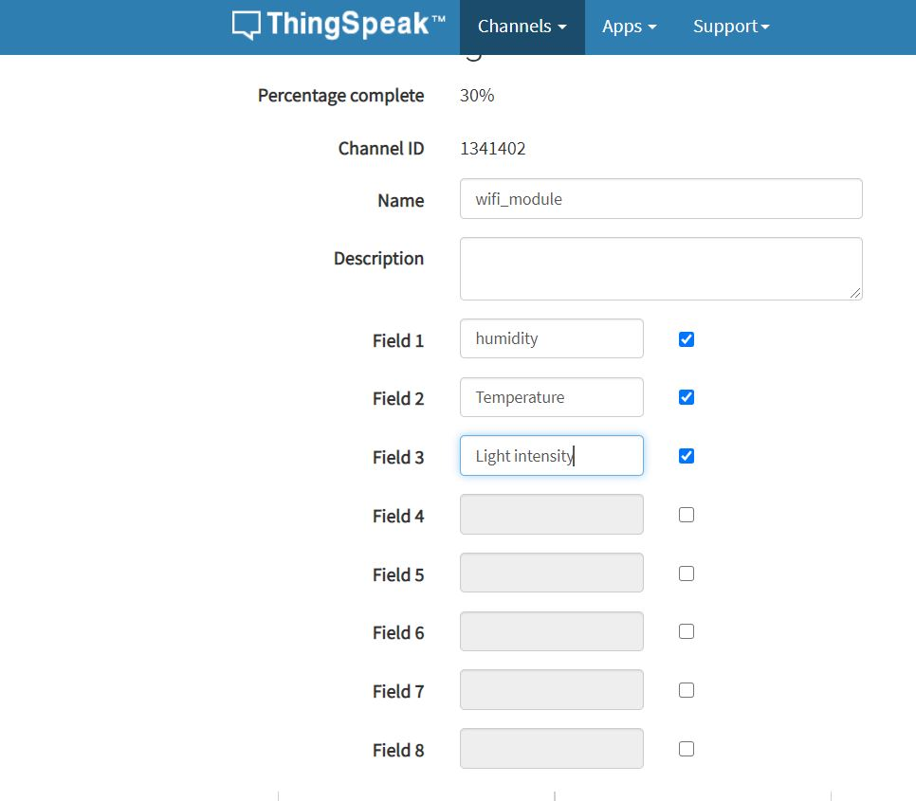
Fields:

Slide 19
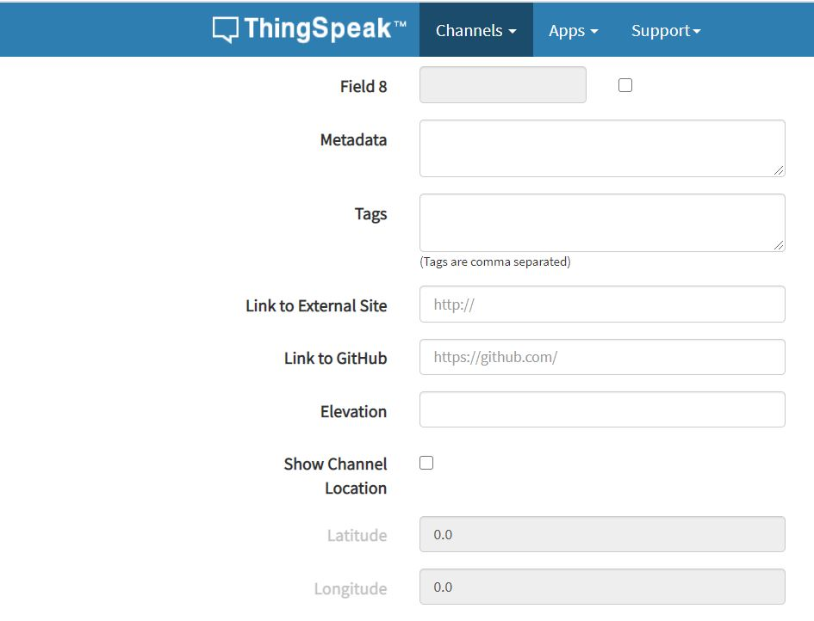
Location fields
3 location fields - Can be used to store the latitude, longitude and the elevation. These are very useful for tracking a moving device.

Slide 20
Status fileds
1 status field - A short message to describe the data stored in the channel.

Slide 21
Significance of various fields
Latitude, longitude and elevation - These fields correspond to the location of a ‘thing’ and are especially significant for moving things.
Make Public? - If the channel is made public, anyone can view the channel's data feed and the corresponding charts. If this check box is not checked, the channel is private, which means for every read or write operation, the user has to pass a corresponding API key.
Fields 1 to 8 - These are the fields which correspond to the data sent by a sensor or a ‘thing’

Slide 22
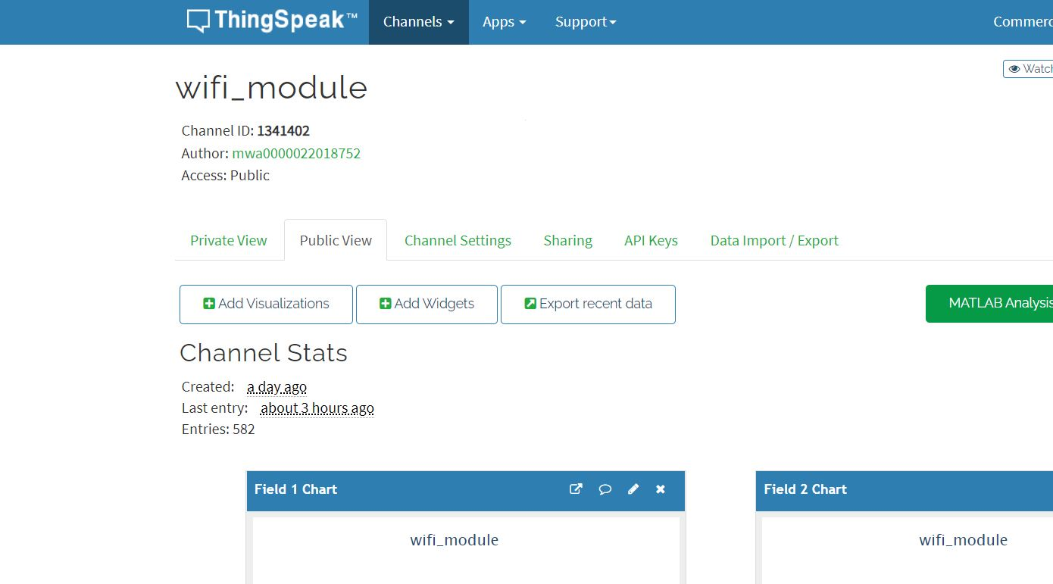
Once you have edited the fields, click on ‘Save Channel’ button. You should now see a page like the below in which the ‘Private View’ tab is defaulted:

Slide 23
Private and public view
The Private View shows a chart corresponding to each of the fields that we have added.
The public view should look exactly similar to the what we see in the ‘Private View’ tab since our channel is public.

Slide 24
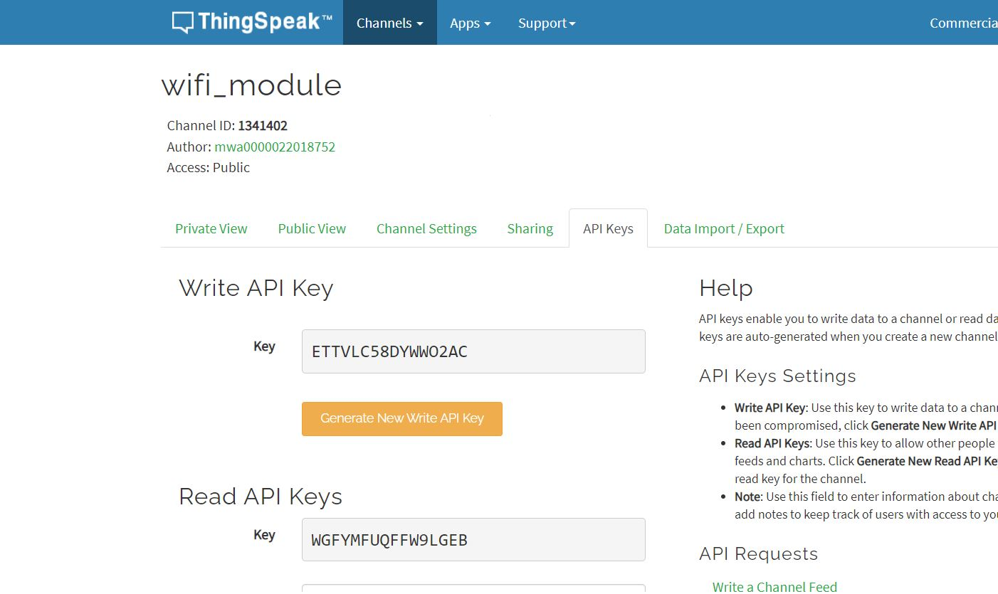

Api Keys
When you read or write data to your channel using the ThingSpeak™ API or MATLAB® code, you need the appropriate read and write permissions. The 16-digit API key allows you to read from a private channel and write to a channel. You do not need an API key to read from a public ThingSpeak channel.

Slide 25

INTERFACING

Slide 26
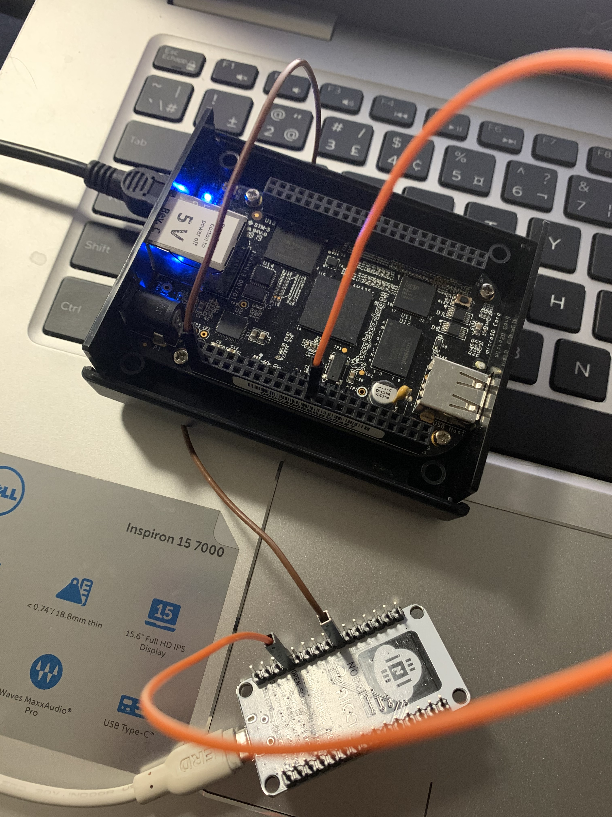
Connection
BBB | ESP8266
P9_24(UART1_TXD) | RX
P9_2(GND) | GND

Slide 27
In order to use Arduino IDE to program Node MCU,We have to introduce it to the software first.
To do this copy the following code and follow the steps below:
http://arduino.esp8266.com/stable/package_esp8266com_index.json

Slide 28
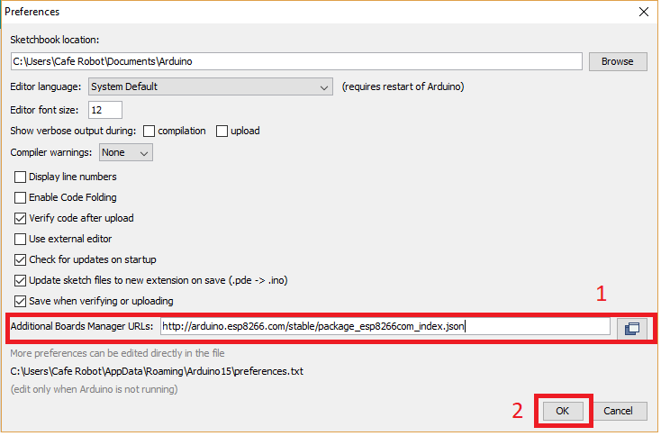
step1. Choose Preferences in the File menu and enter the copied code in Additional Board Manager URLs part. Then press OK.

Slide 29
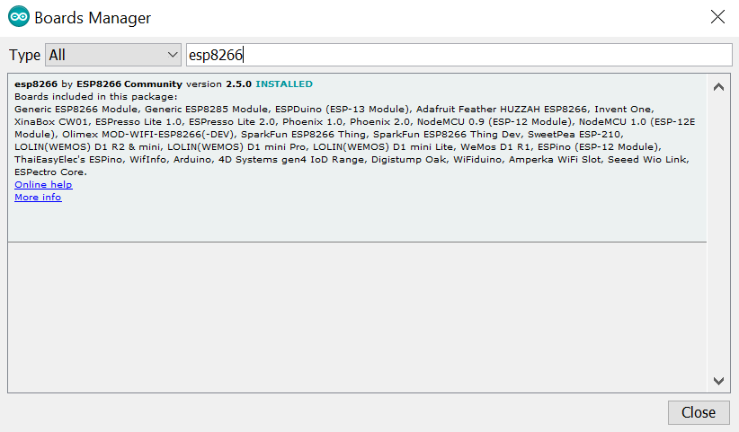
Step2. Search the word ESP8266 in Boards>boards manager from Tools menu. Then install ESP8266 boards. After complete installation, you will see the INSTALLED label on ESP8266 boards.

Slide 30
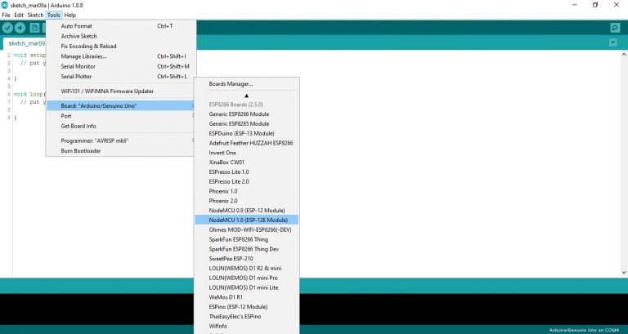
Cont..
After these two steps, you can see ESP8266 based boards such as NodeMCU in your Arduino IDE boards list, and you can choose your desired board to upload the code.

Slide 31
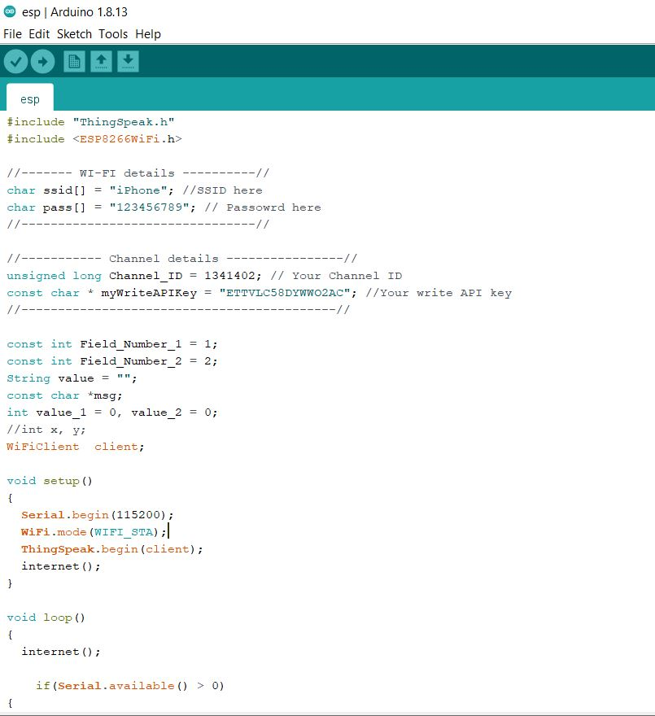
CODE

Slide 32
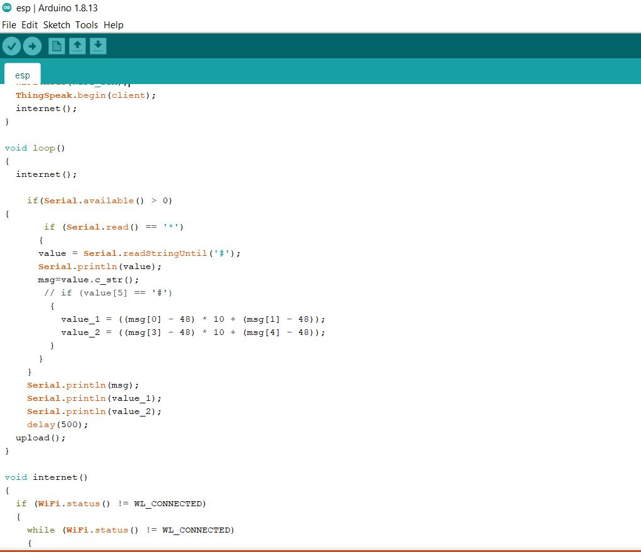

Slide 33
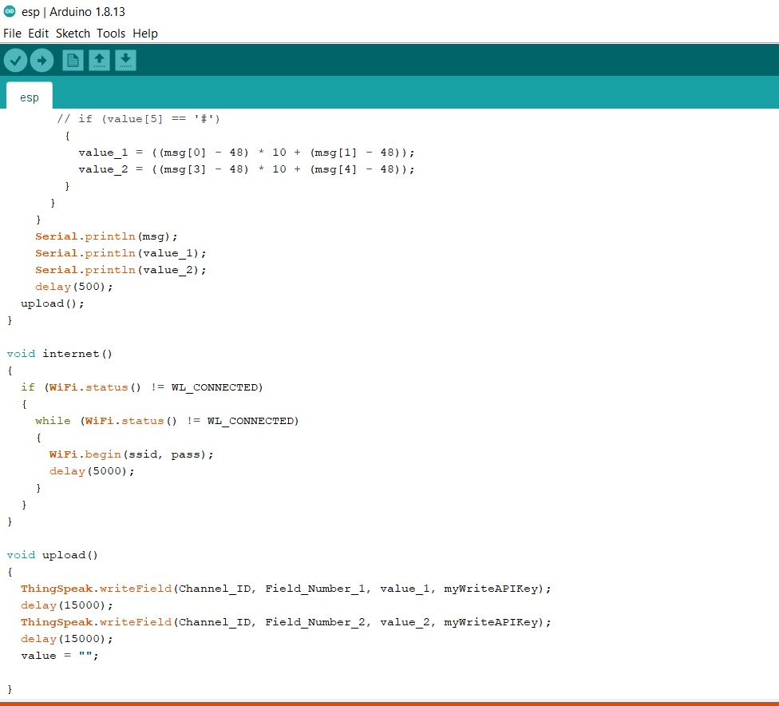

Slide 34
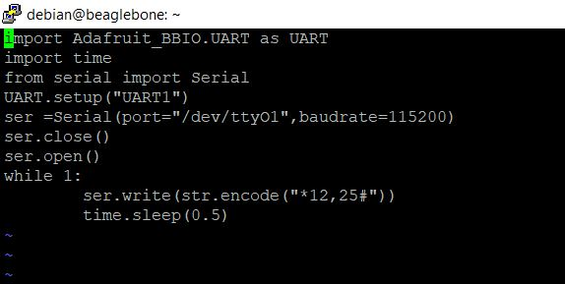
BBB code
Upload this code to the BBB.

Slide 35
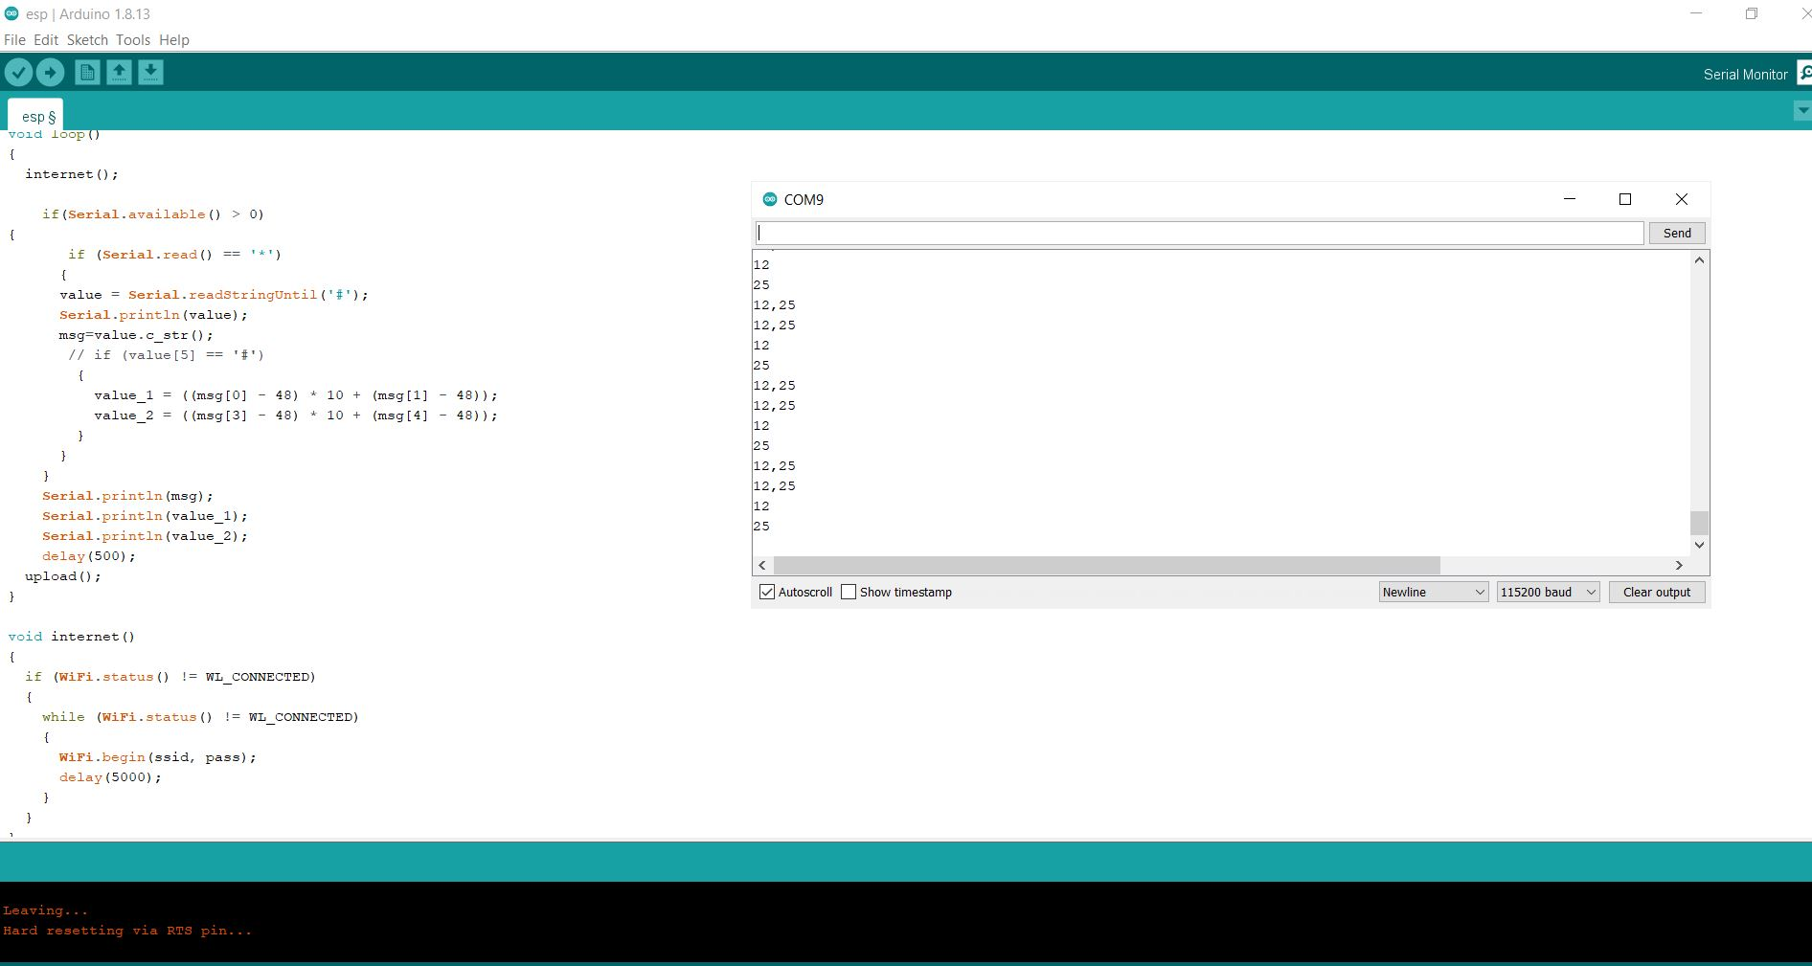
Final output
Serial monitor

Slide 36
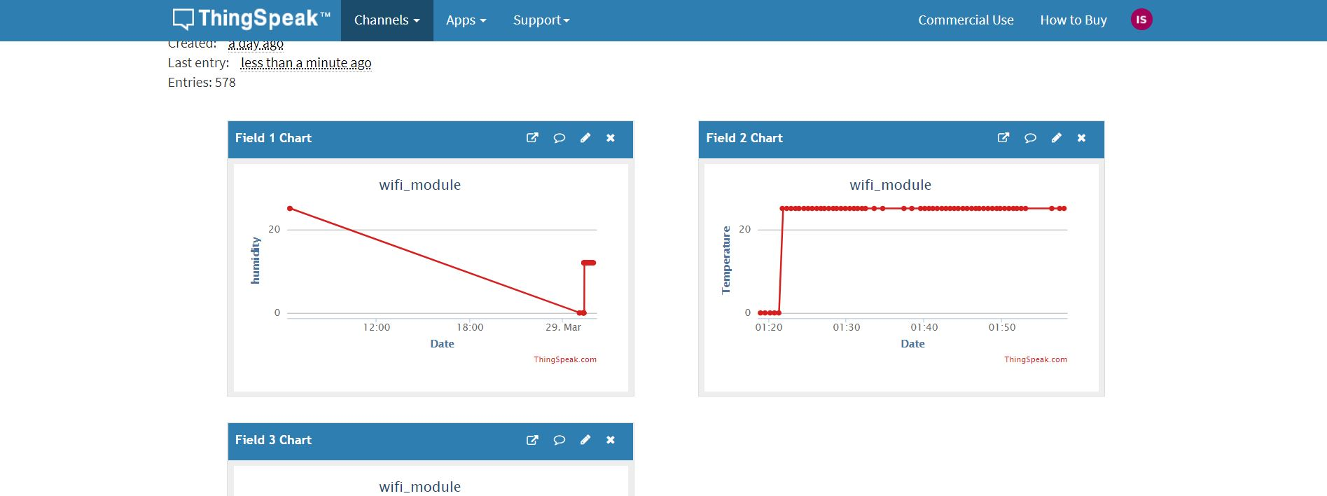
Data uploaded to the thingspeak
Thingspeak channel

Slide 37
References
Node mcu esp8266:
https://electropeak.com/learn/nodemcu-esp8266-on-arduino-ide/
Thingspeak: https://www.codeproject.com/Articles/845538/An-Introduction-to-ThingSpeak

Slide 38
ESP8266: https://components101.com/development-boards/nodemcu-esp8266-pinout-features-and-datasheet

Slide 39
THANKYOU

